Slide 1


REAL TIME FACE MASK DETECTION
PANIMALAR ENGINEERING COLLEGE
DEPARTMENT OF COMPUTER SCIENCE AND ENGINEERING
CS8811 PROJECT WORK
REVIEW NO:1
Guide Name: M.Rajendiran
Team Members : Mritesh M, Valaparla Akhil Tagore, Vengiswaran AL
Batch No: C11

Slide 2
Abstract:
Effective strategies to restrain the COVID-19 pandemic need high attention to mitigate negatively impacted communal health and global economy, with the brim-full horizon yet to unfold.
It is necessary to build a model that detects people with and without masks in real-time as it works as a simple precautionary measure to prevent the spread of the virus.
These models based on deep convolutional neural networks are widely being developed to improve the accuracy and performance of such detection systems.
The input is obtained in real-time via a webcam. A “bounding box” that displays whether the user is wearing a mask or not is displayed as the output.
We will be using CNN and Deep convolutional layers to efficiently. The existing systems for face mask detection have proved to be less accurate and less efficient.

Slide 3
They are not very effective as the dataset available for detecting masks on human faces is relatively small leading to the hard training of the model.
We propose a model for face mask detection that leverages CNN to detect whether the user is wearing a face mask or not.
It is different from previously existing methods as it possesses a custom GUI.
After Image de-Colorization and contouring only, it creates a dataset, hence the dataset is very pure.
The advantages of this system are high accuracy, fast processing, high efficiency, and better performance.
If deployed correctly, this deep learning-based application helps in simplifying the work of frontline warriors and saving their lives.
The real-time applications of the proposed system are that it can be used in healthcare, at crowded places like airports, railway stations as well as multinational corporations with a workforce of more than 50 people.

Slide 4
Existing System:
Manual monitoring is in general hard to enforce because of the manpower needed to efficiently protect public spaces and ensure that individuals are wearing masks correctly
The current systems are based on a machine learning approach and are highly prone to errors.
Although face mask detection results achieved are promising, these traditional approaches are still far from being highly accurate and efficient.
The existing systems are simple and effective but are extremely vulnerable to impact.
Moreover, state-of-the-art methods can predict outputs pertaining to certain parts of the organ only while some severe conditions may go completely undetected.
This could lead practitioners to false assumptions and improper diagnosis and treatments provided to patients

Slide 5
Existing System Drawbacks:
The existing systems are also not robust in detecting face masks on a human face, as the characteristics of the diseases vary in terms of time due to changes in climate, geographical, and biological aspects.
Many of the current techniques are computer vision-based models, which are less accurate and efficient
The discussed limitations have been overcome to enhance the performance of face mask detection models successfully in the presented application.
The existing models cause unsatisfactory results & excessive trouble to the general public and authorities.

Slide 6
Proposed System:
DL allows analyzing and interpreting massive volumes of data in a fast and accurate way.
We propose to use MobileNetV2 architecture to ensure accurate face-mask detection.
The proposed approach provides accurate detection of face mask-wearing and whether it is worn in an appropriate way or not in real-time.
The first stage is Pre-processing. Images in training dataset are subjected to Pre-processing to avoid false predictions and to enhance the quality of images.
Live capture of multimedia impressions is used for detailed analysis and predictions.
To do this, a complete dataset is created after Image de-Colorization and contouring, hence the dataset is very pure

Slide 7
In addition, the MobileNetV2 is used as a DL architecture for facemask detection. This approach has the advantage to be fast and suited to edge devices, and it provides excellent results for object detection.
This approach has the advantage to be fast and suited to edge devices, and it provides excellent results for object detection.
The proposed approach achieved 99% accuracy in training and testing and can determine whether a mask is appropriately worn or not in real-time video streams
If deployed correctly, this deep learning technique helps in simplifying the work of frontline warriors and saving their lives.
The program can also be linked to the entrance gates, allowing only those who are wearing masks to enter. It can also be used in shopping malls and universities.

Slide 8
Proposed System Advantages:
The novelty of this paper with regard to exiting works is proposing an efficient and accurate approach for real-time videos.
The proposed model works well against train data and test data further this model will provide better results for real-time data.
The application is beneficial for conditions where data has to be processed in a short time and results are required instantly.
The proposed device might be deployed in high-traffic areas to keep a close eye on people.
If we consider the cost estimation for implementing the project, it will be almost of no cost as most of the metropolitan cities already have cameras installed in public places.
The camera; which is the only main requirement of the proposed model is already available.
We propose to use MobileNetV2 architecture to ensure accurate face-mask detection, which has high accuracy.
A fast and cost-efficient and quick method.

Slide 9
List Of Modules:
GUI and Data Preprocessing
Training Neural Networks
Classification and Output

Slide 10
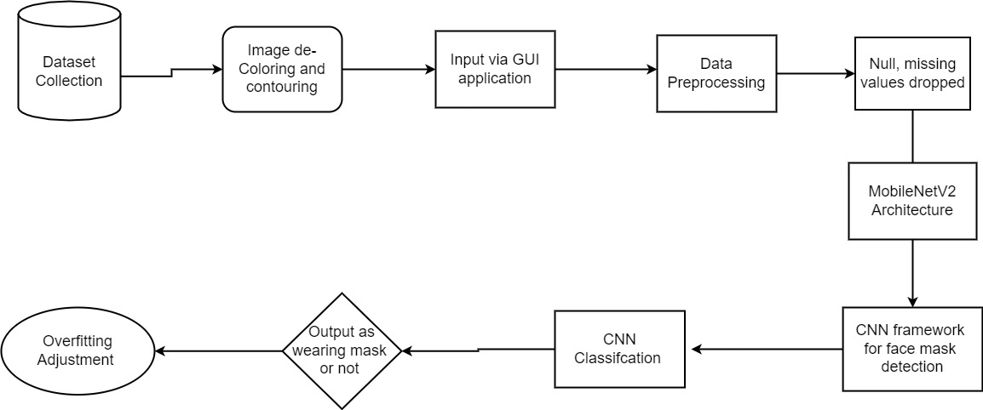
System Architecture:

Slide 11
Literature Survey(IEEE,Springer,science Direct):
TitleFace Mask Detection Using Deep Learning,2021 International Conference on Computer Communication and Informatics (ICCCI), 2021
Author: Ravi Kishore Kodali, Rekha Dhanekula
Description:
A basic Convolutional Neural Network (CNN) model is built using TensorFlow, Keras, Scikit-learn and OpenCV to make the algorithm as accurate as possible. Javascript API helps in accessing webcam for real-time face mask detection. Since Google Colab runs on web browser it can't access local hardware like a camera without APIs. The proposed work contains three stages: (i) pre-processing, (ii) Training a CNN and (iii) Real-time classification. If anyone in the video stream is not wearing a protective mask a Red coloured rectangle is drawn around the face with a dialog entitled as NO MASK and a Green coloured rectangle is drawn around the face of a person wearing MASK.

Slide 12
Literature Survey:
Title: Real-time Facemask Detector using Deep Learning and Raspberry Pi, 2021 International Conference on Digital Age & Technological Advances for Sustainable Development (ICDATA), 2021
Author: Ikram ben Abdel Ouahab, Lotfi Elaachak, Mohammed Bouhorma, Yasser A. Alluhaidan
Description:
Proposed is a facemask detector based on IoT embedded devices and deep learning algorithms. The proposed solution generates loud vocal alerts after detection disrespect of facemask wear in real-time for a fast reaction. To have the most efficient detector in real-time we tested the facemask detection model using various versions of the Raspberry Pi and NCS2. As a result, the facemask detector works perfectly on powerful devices, however its performance decrease in real time using less powerful devices such as an old version of the Raspberry Pi.

Slide 13
Literature Survey:
Title: Face mask detection using YOLOv3 and faster R-CNN models: COVID-19 environment, Multimedia Tools and Applications volume 80, pages 19753–19768, 2021
Author: Sunil Singh, Umang Ahuja, Munish Kumar, Krishan Kumar, Monika Sachdeva
Description:
Proposed is an efficient real-time deep learning-based technique to automate the process of detecting masked faces, where each masked face is identified in real-time with the help of bounding boxes. Faster RCNN and YOLO v3. F-RCNN has better precision, but for applying this in real-world surveillance cameras, it would be preferred to use the model with YOLO algorithm as it performs single-shot detection and has a much higher frame rate than Faster-RCNN or any other state-of-the-art object detection algorithms.

Slide 14
Conclusion:
An efficient CNN model based on MobileNetV2 for Real-time Facemask Detection is presented.
The backbone of the MobileNet face detection architecture is MobileNet, with dense as the last layer.
The proposed approach achieved 99% accuracy in training and testing and can determine whether a mask is appropriately worn or not in real-time video streams.
The advantages of this system are high accuracy, fast processing, high efficiency, and better performance.
As future work, further experiments will be conducted to evaluate the performances of the proposed solution.
In addition, we plan to implement the proposed solution in real-world surveillance cameras in public areas to check if people are following rules and wearing masks appropriately.
An alarm system can also be implemented to make a sound when someone without a mask enters the area or laser detectors that mark the individual who is not wearing a mask.

Slide 15
THANK YOU

